Slide 1




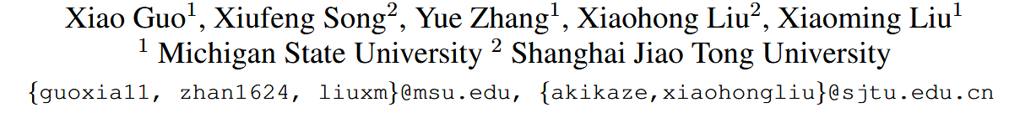





ATAI
Advanced Technique of Artificial Intelligence
ATAI
ChongqingUniversity _{AdvancedTechniqueof}
of Technology Artificial Intelligence
Chongqing University of Technology
Chongqing University ^{ATAI}
_{of Technology} Advanced Techniqueof
Artificial Intelligence
Chongqing University of Technology
Chongqing University of Technology
Rethinking Vision-Language Model in Face Forensics: Multi-Modal Interpretable Forged Face Detector
code:https://github.com/CHELSEA234/M2F2_Det
—— CVPR ’25
Reported by Shu Ming Jiang
1

Slide 2
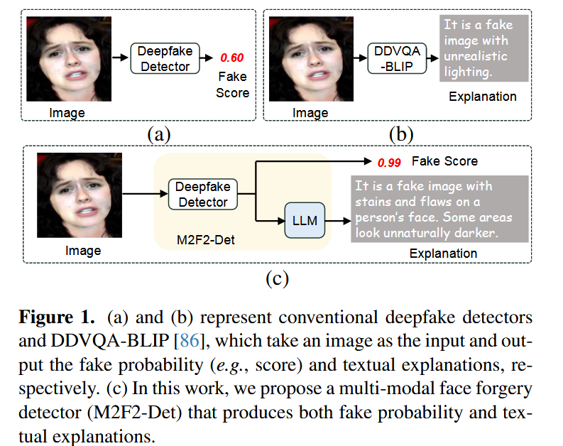
ATAI
Advanced Technique of
Artificial Intelligence
ATAI
ChongqingUniversity _{AdvancedTechniqueof}
of Technology Artificial Intelligence
Chongqing University of Technology
Motivation
1)Unlike prior methods that provide either binary classification results or textual explanations separately, we introduce a novel method capable of generating both simultaneously.
2) DDVQA-BLIP relies on a general text-generation model without dedicated mechanisms for deepfake detection, resulting in lower detection accuracy compared to conventional binary detectors.
3)Prior CLIP-based detectors often lack effective input text prompts to describe diverse forgeries, restricting the adaptation of CLIP’s multi-modal learning ability in the detection task.

Slide 3
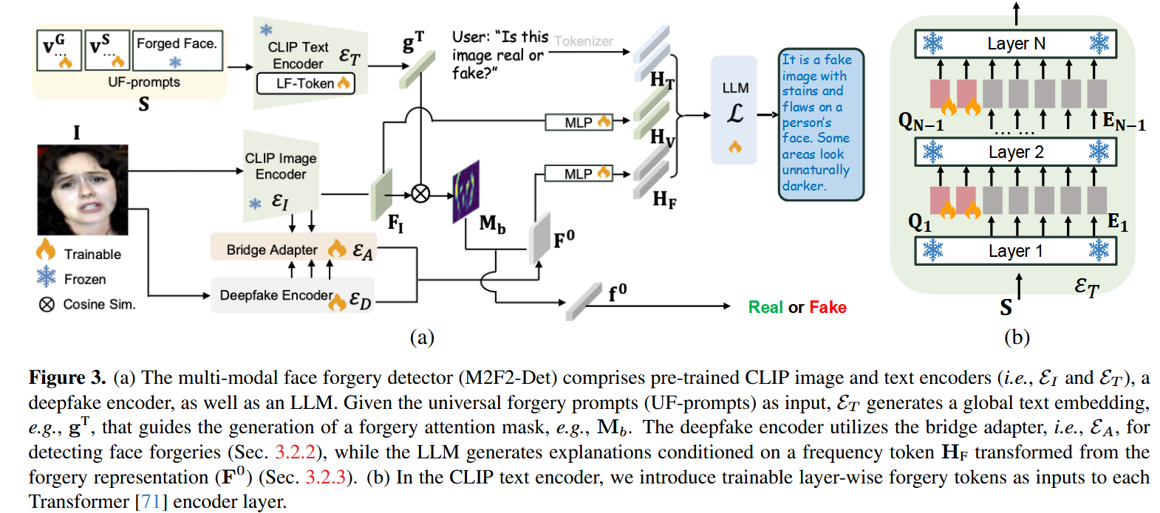
ATAI
Advanced Technique of
Artificial Intelligence
ATAI
ChongqingUniversity _{AdvancedTechniqueof}
of Technology Artificial Intelligence
Chongqing University of Technology
Overview

Slide 4
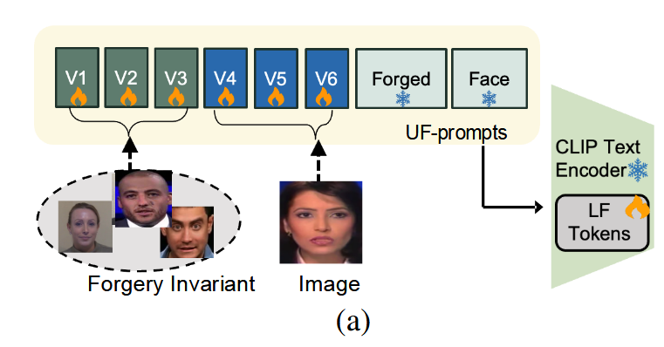



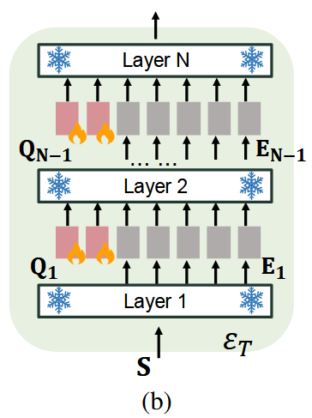

ATAI
Advanced Technique of
Artificial Intelligence
ATAI
ChongqingUniversity _{AdvancedTechniqueof}
of Technology Artificial Intelligence
Chongqing University of Technology
Method

Slide 5

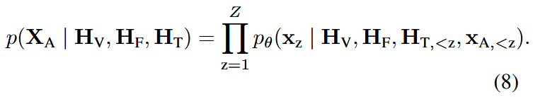
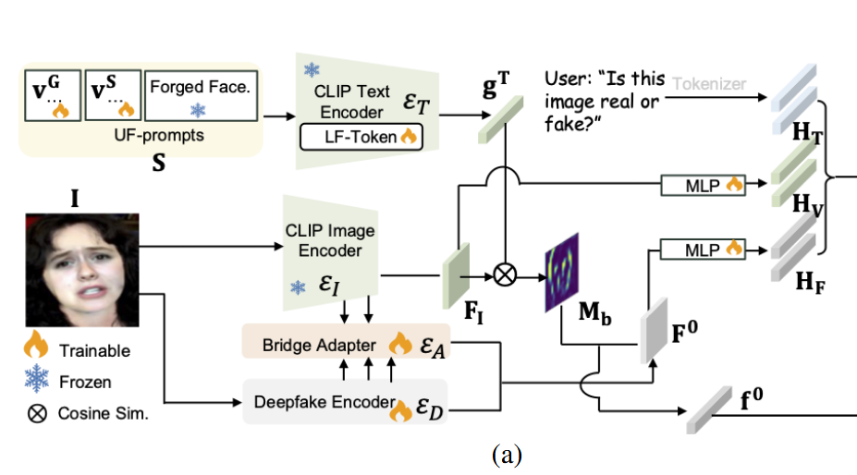
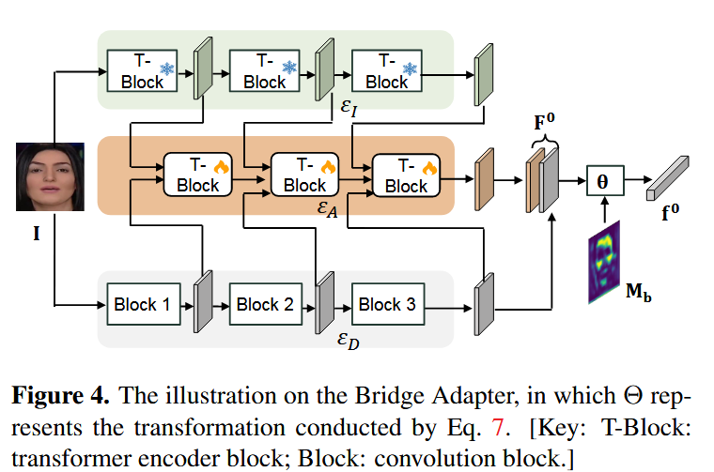
ATAI
Advanced Technique of
Artificial Intelligence
ATAI
ChongqingUniversity _{AdvancedTechniqueof}
of Technology Artificial Intelligence
Chongqing University of Technology
Method

Slide 6
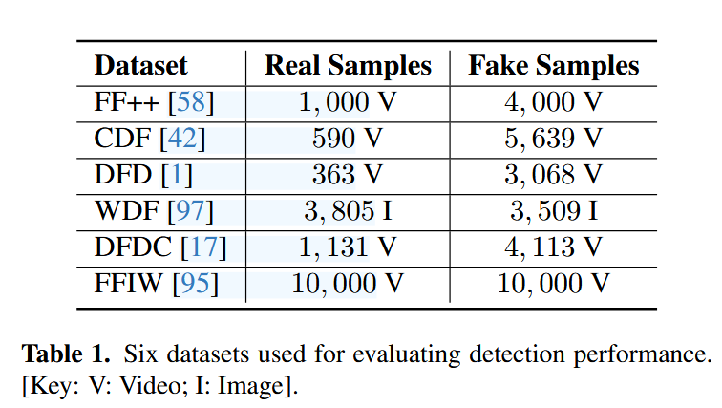
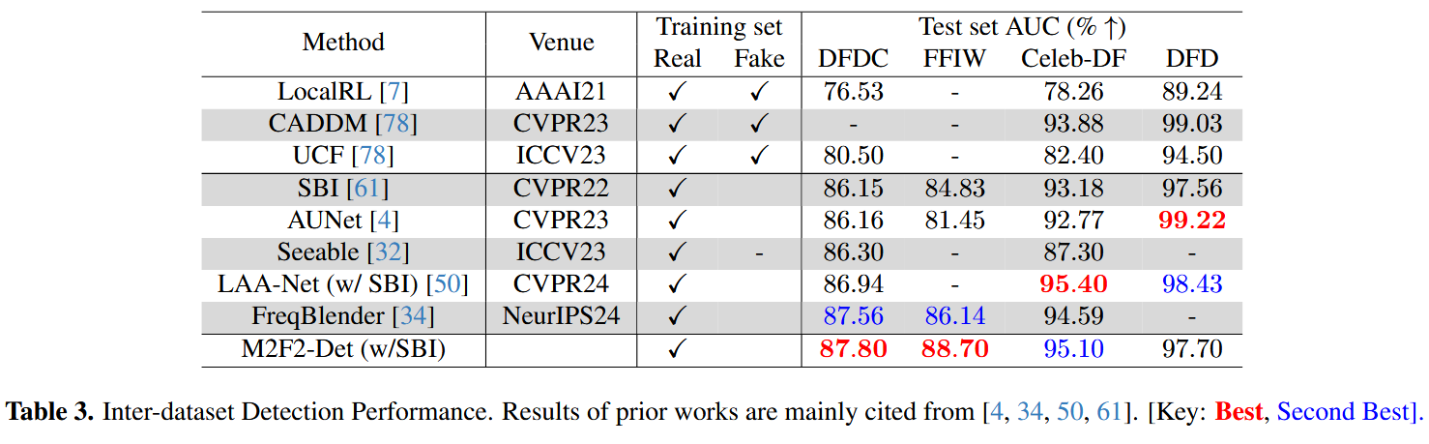
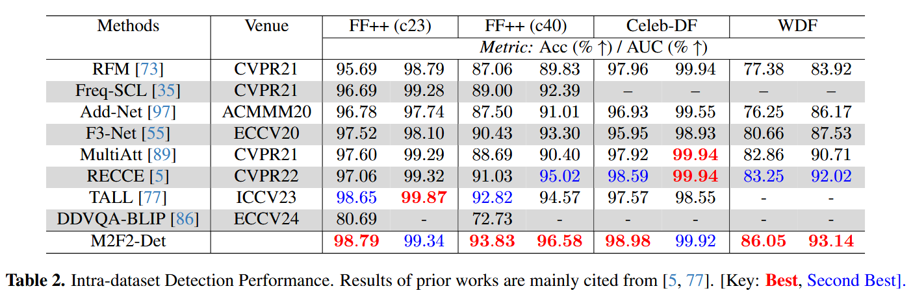
ATAI
Advanced Technique of
Artificial Intelligence
ATAI
ChongqingUniversity _{AdvancedTechniqueof}
of Technology Artificial Intelligence
Chongqing University of Technology
Experiments

Slide 7
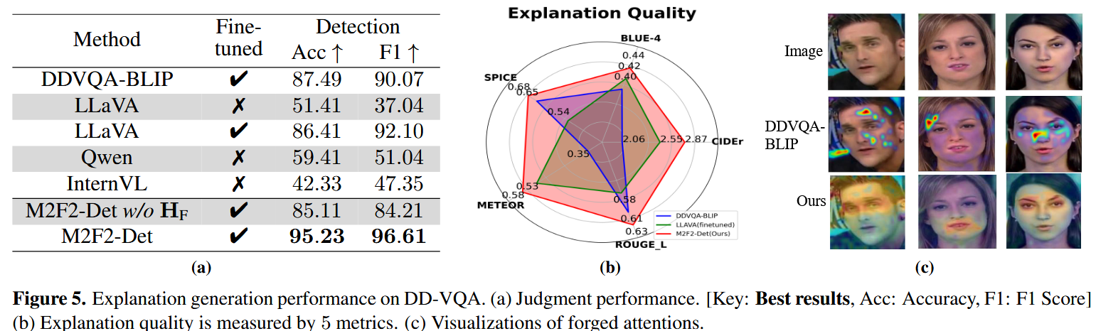
ATAI
Advanced Technique of
Artificial Intelligence
ATAI
ChongqingUniversity _{AdvancedTechniqueof}
of Technology Artificial Intelligence
Chongqing University of Technology
Experiments

Slide 8
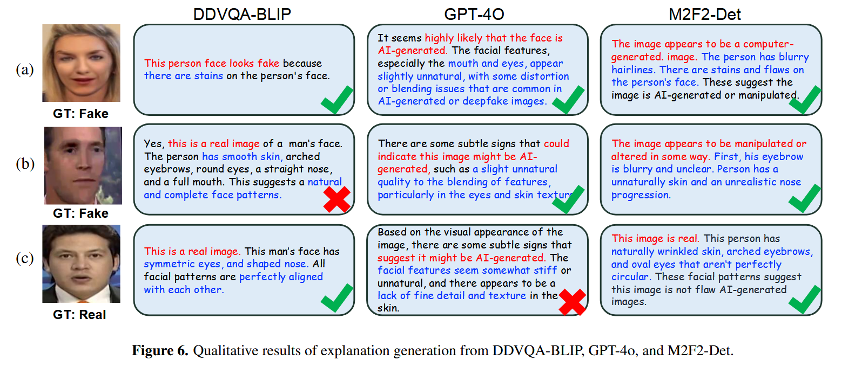
ATAI
Advanced Technique of
Artificial Intelligence
ATAI
ChongqingUniversity _{AdvancedTechniqueof}
of Technology Artificial Intelligence
Chongqing University of Technology
Experiments

Slide 9
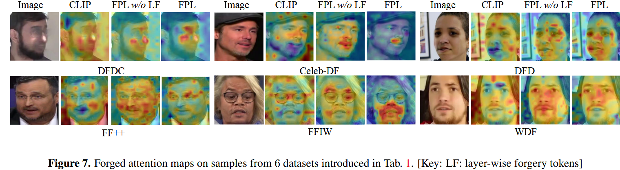
ATAI
Advanced Technique of
Artificial Intelligence
ATAI
ChongqingUniversity _{AdvancedTechniqueof}
of Technology Artificial Intelligence
Chongqing University of Technology
Experiments

Slide 10
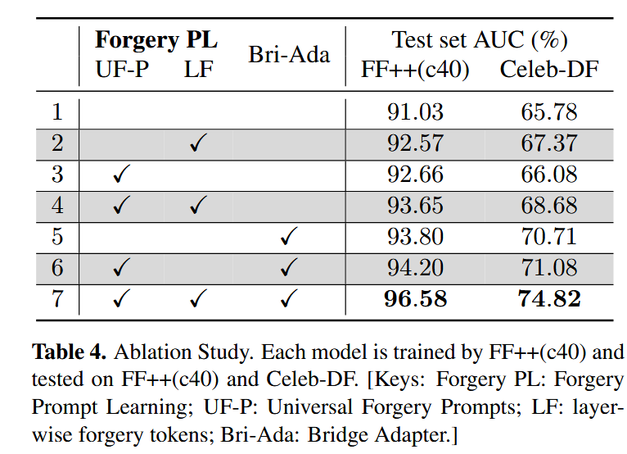
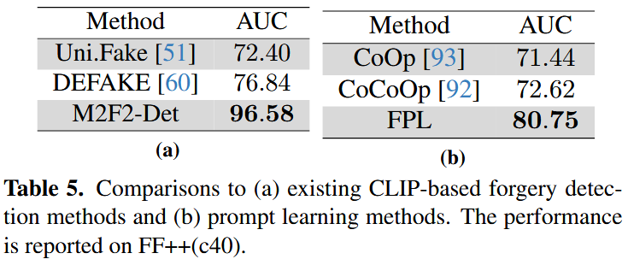
ATAI
Advanced Technique of
Artificial Intelligence
ATAI
ChongqingUniversity _{AdvancedTechniqueof}
of Technology Artificial Intelligence
Chongqing University of Technology
Experiments

Slide 11


ChongqingUniversity of Technology
ATAI
Advanced Technique of
Artificial Intelligence
ATAI
ChongqingUniversity _{AdvancedTechniqueof}
of Technology Artificial Intelligence
Chongqing University of Technology
Thanks!

